Slide 1

MACHINE LEARNING ACCELERATOR
Graph Machine Learning – Lecture 1
Notes:
Welcome to Machine Learning Accelerator – Graph Machine Learning course
Day 1

Slide 2
Learning Outcomes
Fundamental understanding of graph theory, basics of ML and application of ML algorithms on real world graphs
Understanding graph based ML algorithms, particularly Graph Neural Networks (GNNs)
Hands on experience of the DGL framework for representation learning on graphs
Notes:
This course provides a fundamental understanding of Machine Learning, in particular working with Graph Data.

Slide 3


Machine Learning Resources
Notebooks to build, train, and deploy machine learning models quickly
D2L: An interactive deep learning book with code, math, and discussions.
Your
classmates
Collaborate
Share ideas
Connect
Network
Learn
Notes:
We mentioned this already,
since the most important thing for ML is writing code and experimenting hands-on it's important that we have a great platform for experimenting with code.
Jupyter Notebook is the most popular tool for doing DS/ML in Python
This is what we will be using throughout this class.
We can only cover so much in this accelerated dive into ML,
Check out at d2l.ai the open-source (text)book, Dive into Deep Learning (D2L),
Amazonians’ attempt to make deep learning approachable with Jupyter notebooks.
To learn more about ML models, in particular DL
You can run every section locally, on EC2, or on SageMaker.
As of now, D2L has been used for teaching by MLU and 140+ universities from 35 countries.
Check out D2L.ai and star (★) the GitHub repository: https://github.com/d2l-ai/d2l-en.
And, if you are going through this course with a group of ML enthusiasts, being in a classroom or online,
- collaborate, share ideas and experiments, learn from each others mistakes and successes,
to quickly build expertise with these new tools and techniques.

Slide 4
Course Overview
Lecture 1
Lecture 2
Lecture 3
Day 2:
Intro to Graph Theory & Network Analysis
Intro to ML
ML Application on Real World Graphs
DGL at a Glance
Day 2:
Learning on Graphs
Deep Walk
Graph Neural Networks (GNNs)
Graph Convolution Networks (GCNs)
GCNs with DGL
Day 2:
Advanced GNN architectures
Learning on large graphs
Heterogenous Graphs
Case Study : Recommender System with GCNs
AMA

Slide 5
Introduction to
Graphs
Notes:
Let’s dive right in…
First we need to understand how a graph looks like and what it actually means to deal with “graph data”

Slide 6
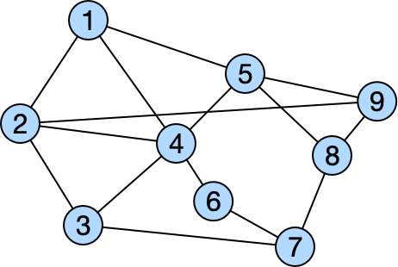
What is a Graph?
“In mathematics and more specifically in graph theory, a graph is a structure amounting to a set of objects in which some pairs of the objects are in some sense "related". ”
COMPUTER
SCIENCE
DATA
PROCESSING
https://en.wikipedia.org/wiki/Graph
Notes:
In the most general view, a graph is simply a collection of objects (i.e., nodes), along with a set of interactions (i.e., edges) between pairs of these objects. For example, to encode a social network as a graph we might use nodes to represent individuals and use edges to represent that two individuals are friends. In the biological domain we could use the nodes in a graph to represent proteins, and use the edges to represent various biological interactions, such as kinetic interactions between proteins.
Network analysis is generally concerned with the properties of real-world data, whereas graph theory is concerned with the theoretical properties of the mathematical graph abstraction.

Slide 7
Why study Graphs?
A common method to model relationships in the world.
Ubiquitous throughout the natural and social sciences, from social networks and knowledge graphs to biomedical graphs and quantum chemistry.
Some times data (relational) can be modelled better through graphs.
Non-Euclidean data and manifolds can be expressed with graphs.
Extracted knowledge from semi-structured data on the Web is stored as graphs.
DATA
PROCESSING

Slide 8
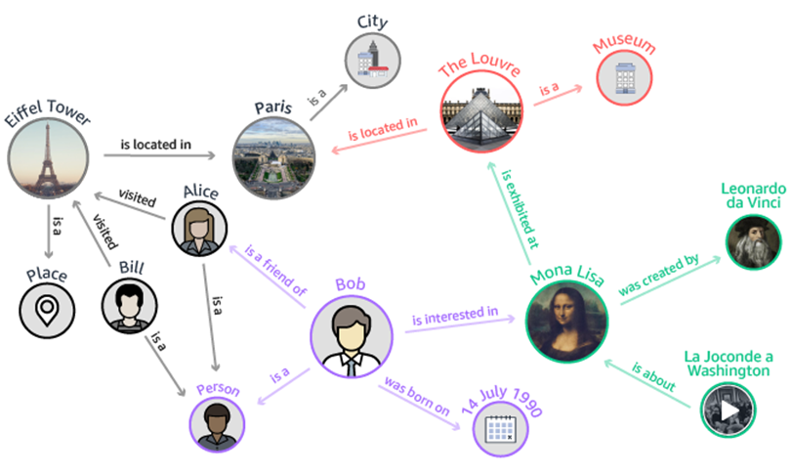
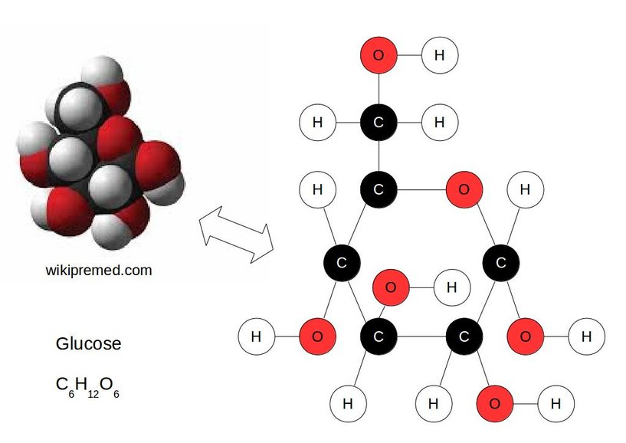
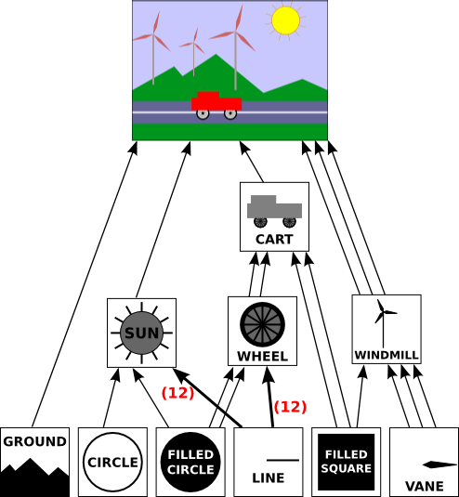
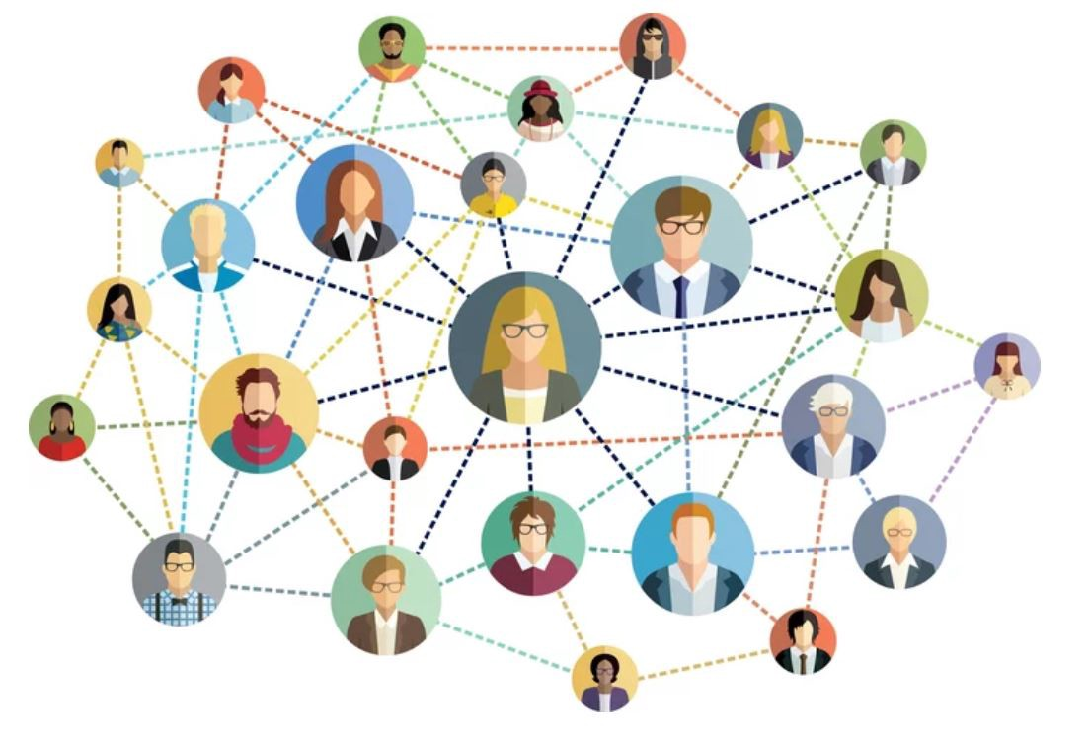
Graphs
Scene Graphs
Knowledge Graphs
Molecular Graphs
Social Network
World Wide Web
Notes:
Some types of graphs that generally form the datasets used in graph machine learning.

Slide 9
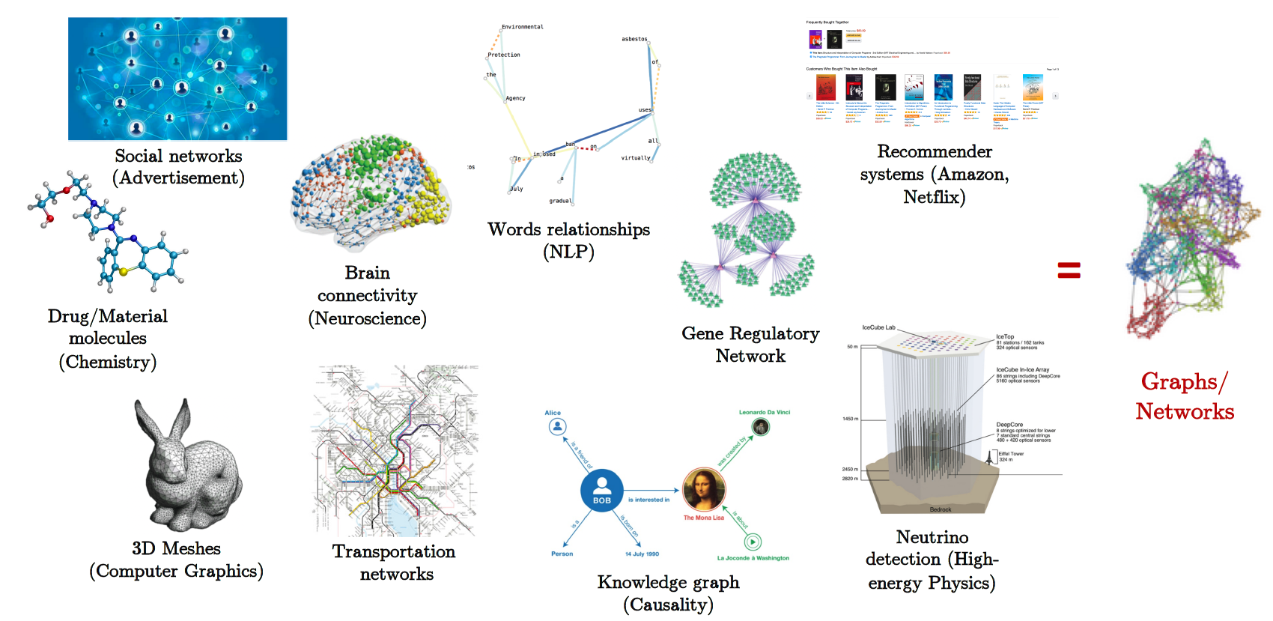
Graphs are Ubiquitous
Notes:
Graphs are a ubiquitous data structure and a universal language for describing complex systems

Slide 10
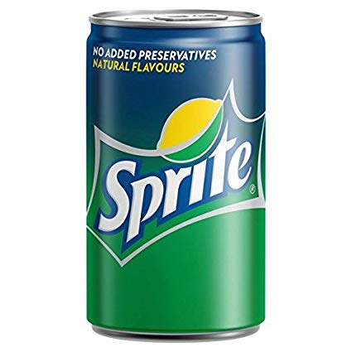

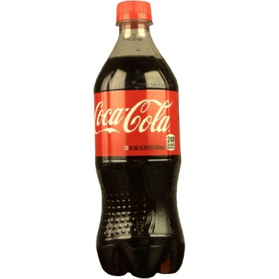
Implicit Graphs
Image as a graph
Pixels → Nodes
Adjacent pixels → Edges
Amazon Catalog as a graph
Products → Nodes
Customers also viewed → Edges
Any dataset as a graph
Objects → Nodes
Objects are similar/close → Edge
Notes:
Not all datasets are in the form of the explicit graphs we just looked at but sometimes we find them as implicit graphs which can be processed and converted into proper graphs which we can utilize for machine learning.

Slide 11
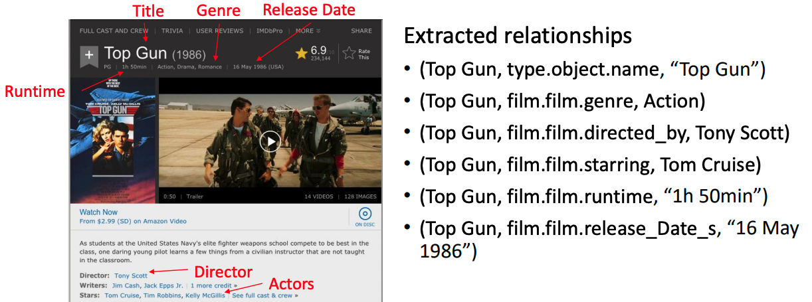
Extracting Knowledge from Semi-Structured Data on the Web
These relation triples can be used to generate a Knowledge Graph
MATHEMATICS
COMPUTER
SCIENCE

Slide 12
What can we do with these graphs?
MATHEMATICS
COMPUTER
SCIENCE
Social Network Link Prediction
Mutagenic? Carcinogenic?
Question Answering
Notes:
Social Nets
Who to follow?
Suggested Friends?

Slide 13
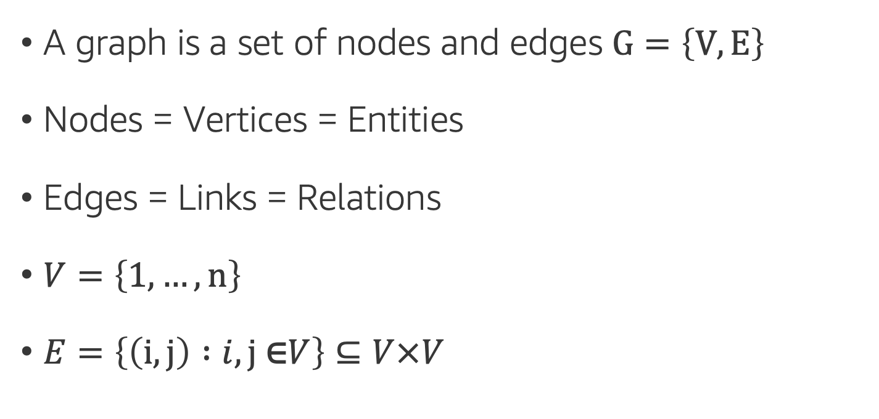
Basic Definitions: Nodes & Edges
A graph is a set of nodes and edges $G=\left\{V,E\right\}$
Nodes = Vertices = Entities
Edges = Links = Relations
$V=\left\{1, …,n\right\}$
$E=\left\{\left(i,j\right) :i,j \text{∈}V\right\}⊆V×V$
MATHEMATICS

Slide 14

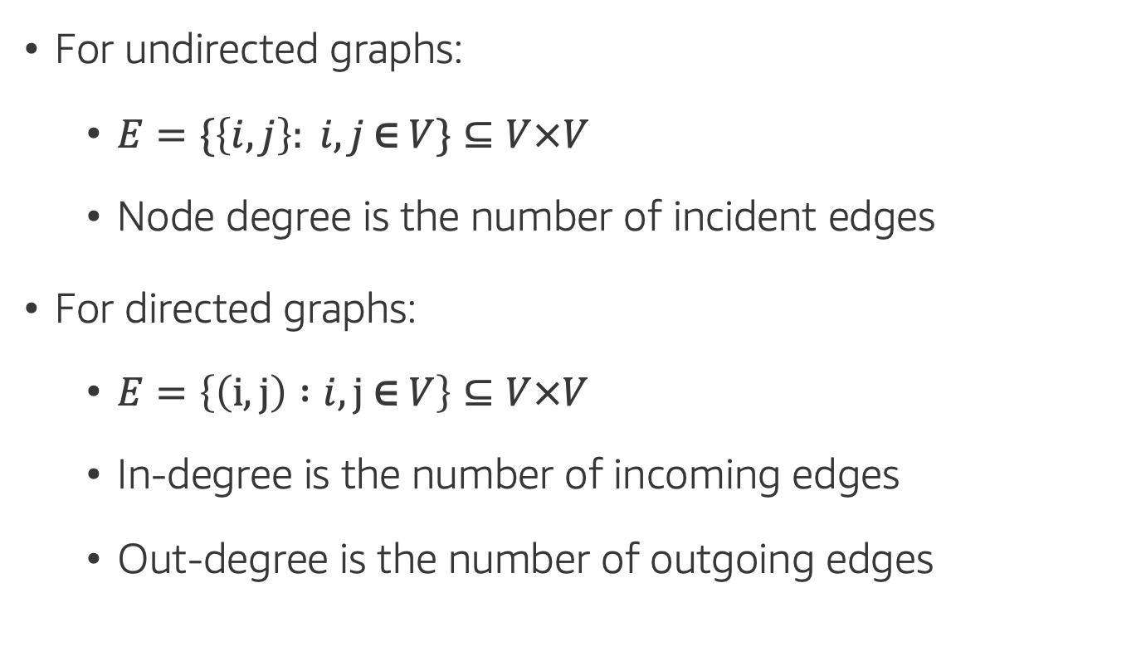
Basic Definitions: Directed & Undirected Graphs
For undirected graphs:
$E=\{\left\{i,j\right\}: i,j \text{∈} V\}⊆V×V$
Node degree is the number of incident edges
For directed graphs:
$E=\left\{\left(i,j\right) :i,j \text{∈} V\right\}⊆V×V$
In-degree is the number of incoming edges
Out-degree is the number of outgoing edges
MATHEMATICS
Undirected Graph
STATISTICAL
RESEARCH
Directed Graph
Notes:
If the graph contains only undirected edges then A will be a symmetric matrix, but if the graph is directed (i.e., edge direction matters) then A will not necessarily be symmetric.

Slide 15
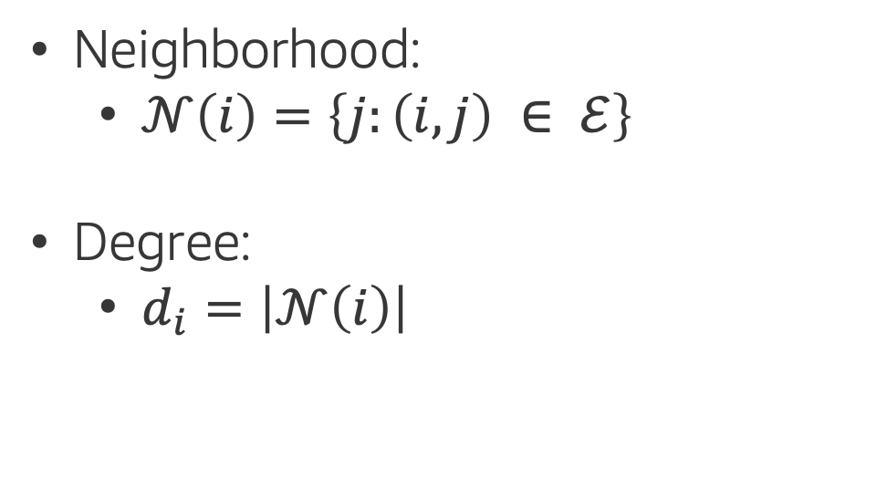
Basic Definitions: Neighborhood
Neighborhood:
$𝒩\left(i\right)=\left\{j:\left(i,j\right) ∈ ℰ\right\}$
Degree:
$d_{i}=\left|𝒩\left(i\right)\right|$
MATHEMATICS
STATISTICAL
RESEARCH

Slide 16
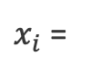
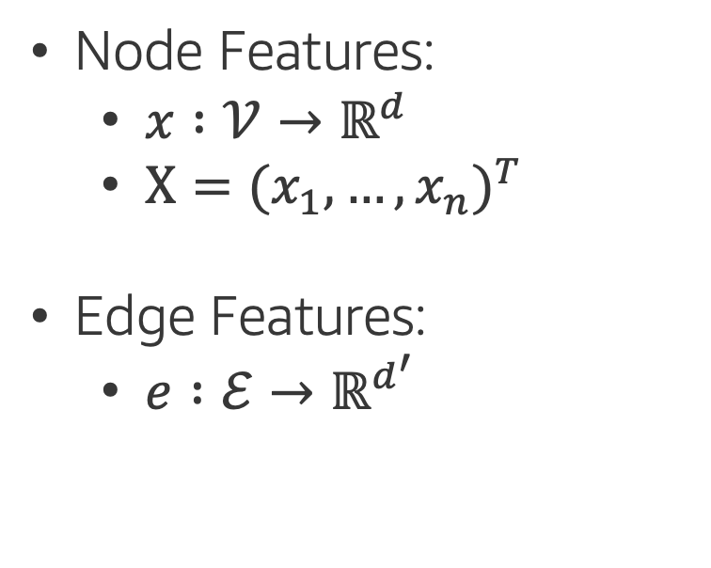
Basic Definitions: Attributes
Node Features:
$x :{𝒱→ℝ}^{d}$
$Χ=(x_{1}, …,x_{n})^{T}$
Edge Features:
$e :{ℰ→ℝ}^{d^{′}}$
MATHEMATICS
$x_{i}$ =

Slide 17
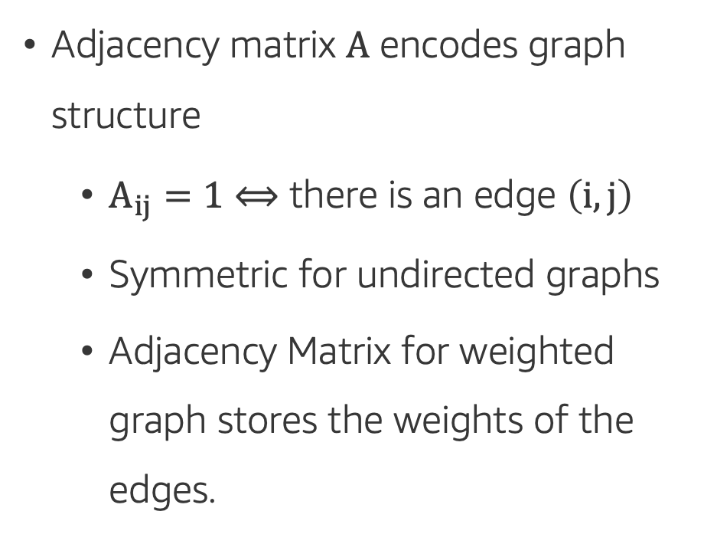
Basic Definitions: Adjacency Matrix
Adjacency matrix $A$ encodes graph structure
$A_{ij}=1⟺$ there is an edge $\left(i,j\right)$
Symmetric for undirected graphs
Adjacency Matrix for weighted graph stores the weights of the edges.
Undirected Graph
Directed Graph

Slide 18
Basic Definitions: Weighted & Unweighted Graphs
A weight is a numerical value attached to each individual edge in the graph.
Weighted Graph will contains weight on each edge where as unweighted does not.
MATHEMATICS
1
STATISTICAL
RESEARCH
2
6
Weighted Graph
Unweighted Graph
Notes:
Some graphs can also have weighted edges, where the entries in the adjacency matrix are arbitrary real-values rather than {0,1}. For instance, a weighted edge in a protein-protein interaction graph might indicated the strength of the association between two proteins.

Slide 19
Basic Definitions: Heterogeneous vs Homogeneous Graphs
Heterogeneous — composed of different types of nodes
Homogeneous — composed of the same type of nodes
MATHEMATICS
COMPUTER
SCIENCE
DATA
PROCESSING
DOMAIN
EXPERTISE

Slide 20
Basic Definitions: More jargon
Multi Graphs: A graph with multiple edges, thus two nodes maybe connected by more than one edge.
Self Loops: An edge that connects the node to itself.

Slide 21
Basic Definitions: More jargon
DAG: It is a directed graph with no directed cycles. Each edge directs from one node to another, such that following those directions will never form a closed loop.
Strongly Connected: A directed graph is strongly connected if there is a path between any two pair of vertices.
Strongly Connected Components: A strongly connected component (SCC) of a directed graph is a maximal strongly connected subgraph.

Slide 22
Introduction to
Machine Learning
Notes:
Let’s dive right in…
most of you must have heard the buzzwords DS/ML ,
let’s see what DS is and where and how ML fits in

Slide 23
What is Machine Learning?
“Programming computers to learn from experience should
eventually eliminate the need for much of this detailed
programming effort”
Arthur Samuel (1959) – Computer Scientist
Problem
Classical Programming (If/else, etc.)
Answers
Rules
Problem
ML Algorithms
Trained ML Models (Rules)
Answers
Answers
New Similar Problem
Notes:
What is Machine Learning?
Arthur Samuel, an American computer scientist, IBMer and pioneer of the field of AI, coined the term in 1959 by stating that
In other words, ML is teaching a machine to do a task,
though algorithms that can learn from data without relying on rules-based programming.
That sounds very similar to classical programming
the key difference is that in programming, you need to provide an exact recipe (code)
that tells the machine what rules to apply to solve a problem and provide answers.
In ML you also provide some code (instructions, ML algorithm),
but that code will tell the machine how to learn based on previous examples (historical data with - when possible - answers)
this code is then used to create a ML trained model
that will further be used to provide answers on new similar data
WHY ML? Why ML got so popular recently?
Some programs/solutions to problems are difficult or impossible to write explicitly
We may quite frankly not know how (task too complex), e.g., face recognition
Or there might be too much relevant data to examine, especially given recent explosion in data collection and data storage

Slide 24
Machine Learning Lifecycle
Answer
New Data/Re-training
Deployment
Business Problems
Data Processing
Data Collection
Data Preprocessing
Data Visualization
Data Augmentation
Feature Engineering
Etc.
Yes
Model
Training
Tuning
Evaluation
Etc.
Meets
Business
Goal?
ML Problem Formulation
No
Notes:
If you identified an ML scenario,
how to do ML? what are the steps to follow?
Putting it all together here as ML Lifecycle, a preview of how much work is ahead
As mentioned, all starts identifying a Business Problem and formulate the ML Problem
This is a step not to taken lightly,
As Albert Einstein said: “If I had an hour to solve a problem I'd spend 55 minutes thinking about the problem and 5 minutes thinking about solutions.”
Once settled on the ML Problem, the next step is also time consuming:
Get all relevant data in one place, cleaned and processed,
ready to be used to train-tune-validate an ML model
that can be deployed and used in production to produce the desired outcomes, if meets the business goals,
or can be tweaked further until meets the bar, otherwise.

Slide 25
Some Important ML Terms
ML | Statistics/Math/other | Simply Put
Label/Target/y | Dependent/Response/Output Variable | The thing you’re trying to predict.
Feature/x | Independent/Explanatory/Input Variable | Data that help you make predictions.
Feature Engineering | Transformation | Processing data to get a more informative starting point.
1d, 2d,… nd | Dimensionality | Number of features.
Model Weights | Parameters | A set of numbers embedded in a model that can predict the labels.
Notes:
We just used a few terms that are very common in ML,
that you might have encountered in other fields of study, as math/stats/eng.
so let’s start decoding some ML terminology.

Slide 26
Graph Machine Learning Applications
Notes:
All looked/worked great with our toy dataset, but real life data – that’s another (long) story
how much data: more data samples, more features
what type of data: numerical, categorical, text (not all numbers ?!)
missing values
different scales (large/small) numerical values
outliers

Slide 27
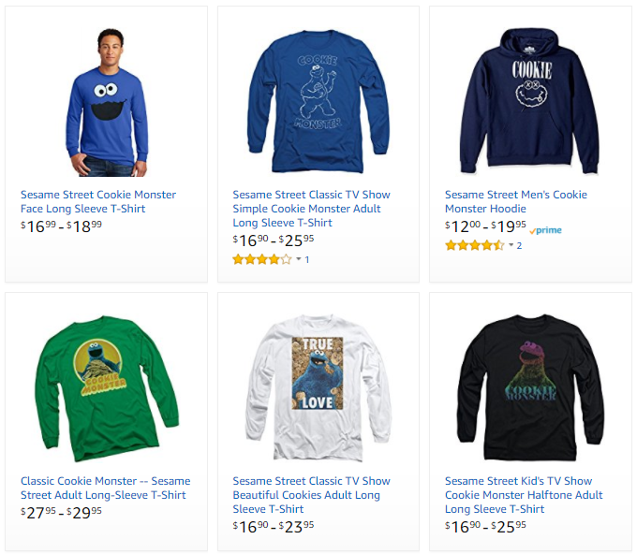
Graph Machine Learning Applications
Problem type
Description
Example
Ranking
Helping users find the most relevant thing
Ranking algorithm within Amazon Search
Recommendation
Suggesting users the movies they may be most interested in, using a knowledge graph
Classification
Figuring out what kind of entity something is
Regression
Predicting a numerical value of an entity in a graph
Clustering
Grouping similar entities in the product graph together
Anomaly Detection
Finding uncommon entities in the graph
Notes:
Let’s also look over some ML applications

Slide 28

Graph Machine Learning Applications
Problem type
Description
Example
Ranking
Helping users find the most relevant thing
Amazon Prime Recommendations
Recommendation
Suggesting users the movies they may be most interested in, using a knowledge graph
Classification
Figuring out what kind of entity something is
Regression
Predicting a numerical value of an entity in a graph
Clustering
Grouping similar entities in the product graph together
Anomaly Detection
Finding uncommon entities in the graph

Slide 29
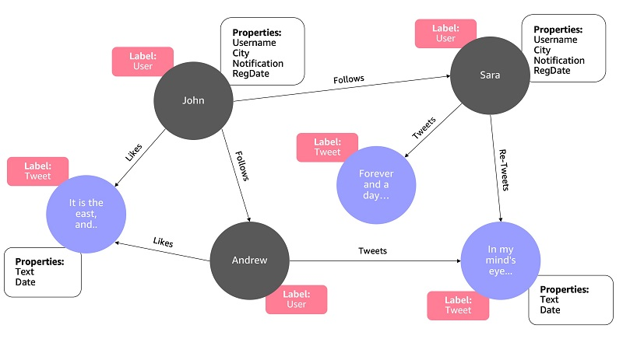
Graph Machine Learning Applications
Problem type
Description
Example
Ranking
Helping users find the most relevant thing
Analyzing Social Media feeds
Recommendation
Suggesting users the movies they may be most interested in, using a knowledge graph
Classification
Figuring out what kind of entity something is
Regression
Predicting a numerical value of an entity in a graph
Clustering
Grouping similar entities in the product graph together
Anomaly Detection
Finding uncommon entities in the graph

Slide 30

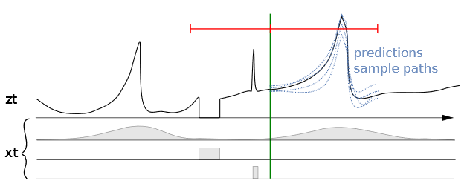
Graph Machine Learning Applications
Problem type
Description
Example
Ranking
Helping users find the most relevant thing
Predicting sales for specific ASINs
Recommendation
Suggesting users the movies they may be most interested in, using a knowledge graph
Classification
Figuring out what kind of entity something is
Regression
Predicting a numerical value of an entity in a graph
Clustering
Grouping similar entities in the product graph together
Anomaly Detection
Finding uncommon entities in the graph
Seasonality | Out of stock | Promotions

Slide 31
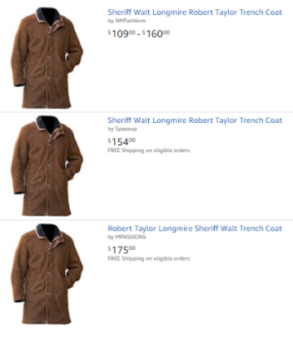
Graph Machine Learning Applications
Problem type
Description
Example
Ranking
Helping users find the most relevant thing
Close-matching for near-duplicates
Recommendation
Suggesting users the movies they may be most interested in, using a knowledge graph
Classification
Figuring out what kind of entity something is
Regression
Predicting a numerical value of an entity in a graph
Clustering
Grouping similar entities in the product graph together
Anomaly Detection
Finding uncommon entities in the graph

Slide 32


Graph Machine Learning Applications
Problem type
Description
Example
Example
Ranking
Helping users find the most relevant thing
Fruit freshness
Recommendation
Suggesting users the movies they may be most interested in, using a knowledge graph
Before
After
Classification
Figuring out what kind of entity something is
Regression
Predicting a numerical value of an entity in a graph
Clustering
Grouping similar entities in the product graph together
Good
Damage
Serious Damage
Decay
Anomaly Detection
Finding uncommon entities in the graph

Slide 33
Supervised vs Unsupervised Learning
Notes:
All looked/worked great with our toy dataset, but real life data – that’s another (long) story
how much data: more data samples, more features
what type of data: numerical, categorical, text (not all numbers ?!)
missing values
different scales (large/small) numerical values
outliers

Slide 34
Supervised vs Unsupervised Learning
Problem type
Description
Supervised Learning
Data is provided with the correct labels
Ranking
Helping users find the most relevant thing
Recommendation
Suggesting users the movies they may be most interested in, using a knowledge graph
Classification
Figuring out what kind of entity something is
Semi-Supervised Learning
Some labeled data with large amounts of unlabeled data
Regression
Predicting a numerical value of an entity in a graph
Clustering
Grouping similar entities in the product graph together
Unsupervised Learning
Data is provided without labels
Anomaly Detection
Finding uncommon entities in the graph
Notes:
As we have touched upon when discussing the ML Lifecycle,
Business P/ML Problem formulation are usually followed by
Data Collection & Data Processing stages
Speaking of data and learning from data, depending on what data we can collect or is provided,
the actual learning would be learning with some labeled data – appropriately called supervised l.
or learning using data without labels, that is unlabeled data – appropriately called unsupervised l.
While there are some gray boundaries when it comes to problem types and learning types,
Classification and Regression are part of SL, while
Clustering is a form of UL.
Ranking, Recommendations and Anomaly Detection are typically supervised, but unsupervised or semi-supervised techniques exist as well.

Slide 35
Supervised vs. Unsupervised Learning
Supervised Learning
Unsupervised Learning
Data is provided with the correct labels
Model learns by looking at these examples
Data is provided without labels
Model finds patterns in data
Regression (Quantity)
Classification (Category)
K-Means
Collaborative Filtering
PCA
Linear
KNN
Neural Net
Trees
SVM
Logistic
Notes:
Another interesting thing about ML is the plethora of ML algorithms to solve the same type of problem.
While certain algorithms tend to perform better than others with certain types of data, no single algorithm outperform all others on all problems.
This concept is called the no free lunch theorem.
And so, for a given task/problem, choose a few algorithms known to work well for the type of data and problem,
and choose the best-performing one
Let’s narrow down initial choices by dividing ML algorithms into categories, based on the task they perform and how they perform it.

Slide 36
Semi-Supervised Learning
It combines a small amount of labelled data with a large amount of unlabelled data during training.
Semi-supervised learning falls between unsupervised learning and supervised learning.
Class 1
Class 2
Unlabeled Data
Notes:
Another interesting thing about ML is the plethora of ML algorithms to solve the same type of problem.
While certain algorithms tend to perform better than others with certain types of data, no single algorithm outperform all others on all problems.
This concept is called the no free lunch theorem.
And so, for a given task/problem, choose a few algorithms known to work well for the type of data and problem,
and choose the best-performing one
Let’s narrow down initial choices by dividing ML algorithms into categories, based on the task they perform and how they perform it.

Slide 37
Supervised Learning: Regression
Supervised Learning
Data is provided with the correct labels
Model learns by looking at these examples
Price
Regression (Quantity)
Classification (Category)
SqFootage
Price | Bedrooms | SqFootage | Age
280.000 | 3 | 3292 | 14
210.030 | 2 | 2465 | 6
… | … | … | …
Linear
KNN
Neural Net
Trees
SVM
Logistic
Notes:
Very popular SL problem type, regression aims to learn relationships and correlations between input features and a continuous output variable,
with the scope of predicting the continuous output variable.
For example, the price of a house corresponds to a certain combination of no of bedrooms, sqfootage, age and so on.
Shown here, a linear regression model, assuming the relationship between the price and sqFootage is linear, that is a straight line.
- as sqf increases the price of the house increases.
Given historical data, prices of houses with these characteristics on the market,
one can learn such a model that can be later used to predict the sale price of a new given home based on its descriptors.
Some ML algorithms that can be used to build such models, are listed here:

Slide 38
Supervised Learning: Classification
Supervised Learning
Data is provided with the correct labels
Model learns by looking at these examples
Class 1 = star
Class 0 = not star
Feature 2
Regression (Quantity)
Classification (Category)
Feature 1
Label
Features
Star | Points | Edges | Size
1 | 5 | 10< | 750
0 | 0 | >9 | 150
… | … | … | …
Linear
KNN
Neural Net
Trees
SVM
Logistic
Notes:
If you’d rather be interested to know whether the house given its characteristics was sold or not, that would be what’s called classification.
The other very popular SL problem type, classification aims to learn relationships between input features and a output variable,
with the scope of separating the data into classes/groups.
For example, the star or not star classes correspond to a certain combination of no of points, edges and size here…
Shown here, a binary classification scenario, that is we only have two classes.
Some ML algorithms that can be used to build classification models, are …

Slide 39
Unsupervised Learning: Clustering
Unsupervised Learning
Feature 2
Data is provided without labels
Model finds patterns in data
Feature 1
Features
K-Means
Collaborative Filtering
PCA
Age | Music | Books
21 | Classical | Practical Magic
47 | Jazz | The Great Gatsby
… | … | …
Notes:
One example of UL is clustering,
That involves grouping unlabeled data points according to their features/attributes.
For example, clustering can be used in market segmentation;
where we try to find customers that are similar to each other whether in terms of behaviors or attributes,

Slide 40
Unsupervised Learning: Clustering
Unsupervised Learning
Feature 2
Data is provided without labels
Model finds patterns in data
Feature 1
Features
K-Means
Collaborative Filtering
PCA
Age | Music | Books
21 | Classical | Practical Magic
47 | Jazz | The Great Gatsby
… | … | …
Notes:
The most common kind of clustering is K-means clustering,
which involves selecting a number of desired clusters and
partitioning the data into these many clusters
such that data points in each cluster are as similar as possible.

Slide 41
Training – Validation – Test Sets
Original Dataset
Training Set
Training Set
(used to train the model)
Validation Set
(used for unbiased evaluation of the model)
Test Set
Test Set
(used for final evaluation of the model)
Learning
Train, tune and validate the model (multiple times!)
Testing
(Final) Test the model
The test set is not available to the model for learning, it is only used to ensure that the model generalizes well on new “unseen” data.
Notes:
Beyond good choices of evaluation metrics to monitor ML model learning, there’s another key factor to discuss when evaluating models -- the datasets!
Just like with any other learning,
how do we make sure the learned model will be useful beyond training?
You know upfront you want to build a model on some data, to be used on other future similar dataset.
The scope of learning is not to repeat something you’ve seen and learned well, but rather how to generalize what you learned to unseen similar data.
In other words, we’re not ultimately interested in training performance/error, we’re interested in test perf/error (perf/error on new data).
One way to ensure your model learning from some dataset will perform well on other similar dataset is
to explicitly build, train, evaluate and test your model on different datasets!
If you are not being given separate train and test datasets, make sure you split your data upfront, into training and test datasets – that is, set apart the test set to test your model build on the training dataset.
We can then estimate test error by pretending we haven’t seen some of our data.
Even then, model building involves some experimentation/tuning (like say what ML alg parameters to choose - these are traditionally called hyperparameters),
With the test set locked away/Without peeking into the test set,
If you still want to measure performance on unseen data as a way of selecting a good model,
one option is to further divide the training dataset into a training set and a validation set.
You then proceed as before but this time you use the validation set to validate the performance and tweak algorithm’s hyperparameters, selecting the model that performs best on this validation set.
You can train this best model on the full training set (including the validation set), for the last time, and this gives you the final model,
that you can test on the test set to get a final good estimate of the generalization error.

Slide 42
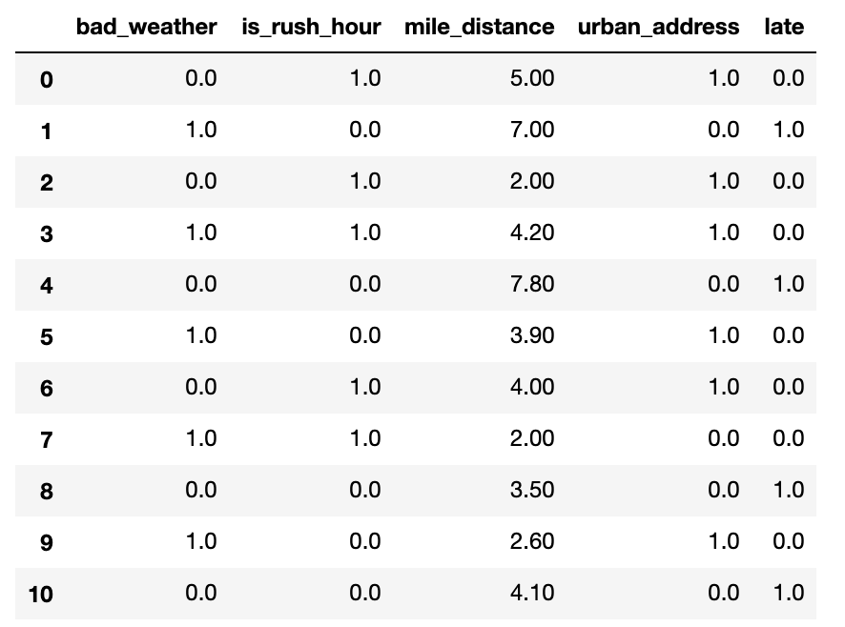
Training – Validation – Test Sets
Original Dataset
Training Set
Training Set
(used to train the model)
Validation Set
(used for unbiased evaluation of the model)
Test Set
Test Set
(used for final evaluation of the model)
Learning
Train, tune and validate the model (multiple times!)
Testing
(Final) Test the model
It is good practice to shuffle the dataset before the split to avoid bias in the resulting sets.
Training Set
Validation Set
Test Set
Notes:
Now that you know what these datasets do, you might be looking for recommendations on how to split your dataset into Train, Validation and Test sets…
You can simply slice your dataset, or use library fcts to split, like the train_test_split from sklearn
It’s also good practice to shuffle the dataset before splitting to avoid bias in the resulting sets.
As for how much of the original dataset should be kept for training and test,
this mainly depends on the total number of samples in your data
Like many other things in machine learning,
the train-test-validation split ratio is quite specific to your case / dataset / algorithm of choice.
Does your choice of alg need more training data to learn?
Does your choice of alg have many hyperparameters to tweak/tune?
Do you have a lot of data to begin with?
Experimenting with different split ratios is the answer, after a while you might get a sense what works best for your particular case.
When we don’t have sufficient data to train/validate your model,
there is another method in town that can help with that …

Slide 43
K-fold Cross Validation ( K = 5)
K-fold Cross-Validation (CV) is a validation technique to see how well a trained model generalizes to an independent validation set.
Use K different holdout samples to validate the model, each time training with the remainder samples:
Split the training dataset into K independent folds.
Repeat the following K times:
Set aside K^{th} fold of the data for validation.
Train the model on the other folds, the training set.
Test the model on the validation set.
Average or combine the model performance metrics.
1st
2nd
3rd
4th
5th
Training
Training
Training
Training
Validation
Training
Training
Training
Validation
Training
Training Set
Validation
Training
Training
Training
Training
Training
Validation
Training
Training
Training
Validation
Training
Training
Training
Training
Average or combine validation performance metrics
Notes:
K-fold CV is a popular validation technique to magically
give you the opportunity to train and validate your choice of model multiple times, say K times,
using the same dataset basically…
Here explained for K = 5
We split the training dataset into 5 independent folds.
And repeat the following 5 times:
Set aside 5th fold of the data for validation.
Train the model on the other folds, the training set.
Test the model on the validation set.
Finally, average or combine the five model performance metrics.
Because K-fold CV is a popular technique to assist with model learning and model tuning
many Machine Learning library functions do this by default!

Slide 44
Model Evaluation: Underfitting
Underfitting: Model is not good enough to describe the relationship between the input data (x₁, x₂) and output y: {Class 1, Class 2}.
Model is too simple to capture important patterns of training data.
Model will perform poorly on training and validation (and/or test).
Class 1
Class 2
x₂
x₁
Notes:
Now, we built a model, we picked a business metric to judge performance of model on the training/validation/test datasets…
What can we learn from examining these metric/scores?
For one, low scores on training, say high regression errors or negative/close to 0 R2, or classification metrics close to 0,
all these, are red flags, telling us that the model didn’t really learn much,
IT IS NOT FIT to do the task is training it for! So It’s UNDERFITTING!
the model did not capture the important patters in the training dataset,
An underfitting model did not perform well on the training,
and is not expected to generalize to new data.
Tweaking model hyperparameters’ could help address overfitting,
Going back to the data processing/feature engineering as discussed over the ML Lifecycle slide is also an option.
Sometimes switching to another ML alg altogether is a better solution!

Slide 45

Model Evaluation: Overfitting
Overfitting: Model memorizes or imitates training data, and fails to generalize well on new “unseen” data (test data).
Model is too complex.
Model picks up the noise instead of the underlying relationship.
Model will perform well on training, but poorly on validation (and/or test).
Class 1
Class 2
x₂
x₁
Notes:
At the other extreme, and more common in ML
is however, when the model works wonders on the training dataset, but fares poorly on the val/test!
How can this be?
The model learns everything is to be learned in the training data, (overdoing it!)
Including every detail and noise in the training data
to the extent that it might negatively impact the performance of the model on future data.
All those details and noise that the model picked from the training data as rules
might not apply to new data,
are not THE generalizable patterns our model was hunting for,
and therefore negatively impact model ability to generalize.
This touches upon the trickiest/most common problem/obstacle in ML: OVERFITIING
Several techniques are available to lessen the chance of, or amount of, overfitting
(reducing the so called generalization gap observed between performance scores on training and validation)
the least we can do it make sure we train and validate our models performance on different datasets!

Slide 46
Model Evaluation: Good Fit
Appropriate fitting: Model captures the general relationship between the input data (x₁, x₂) and output y: {Class 1, Class 2}.
Model not too simple, not too complex.
Model picks up the underlying relationship rather than the noise in the training.
Model will perform good enough on training and validation (and/or test).
Class 1
Class 2
x₂
x₁
Notes:
Ideally, we want to build ML models somewhere in between these two extremes: U and O.
This ideal state is what a good/appropriate fit would be,
- With the understanding that we will have to compromise on models’ performance on the training set,
paying less attention to the noise in the dataset
and concentrate more on the patterns that can be generalized,
that is, can apply with success to future unseen data samples.
This is where the validation set/CV comes in handy,
building models on the training set and validating on the validation sets,
keeping an eye on the performance metrics on validation in particular
aiming for the model that performs good enough on both
Capturing the model that gives us the best validation performance.
Apart from CrossValidation, many other ML techniques and ML algorithms help find such ‘appropriate fit’ models, like
Early stopping - When you’re training an ML model iteratively, you can measure how well each iteration of the model performs. Up until a certain number of iterations, new iterations improve the model. After that point, however, the model’s ability to generalize can weaken as it begins to over fit the training data
Regularization: Regularization refers to a broad range of techniques for artificially forcing your model to be simpler.
Ensembling: Ensembles are machine learning methods for combining predictions from multiple separate models

Slide 47
Model Evaluation
Notes:
Let’s talk about Machine Learning Model Evaluation
How do we know whether the Mach Learning model we built, trained and used to make predictions with, is actually a good model?
How do we evaluate ML models?
What metrics are there to use?
And, what data we (should) use to evaluate models on

Slide 48
Regression Metrics
Metrics | Equations
Mean Squared Error (MSE)
Root Mean Squared Error (RMSE)
Mean Absolute Error (MAE)
R Squared (R²)
: Data values
: Predicted values
: Mean value of data values,
: Number of data records
Notes:
Evaluating REGR models: Let’s first note that all these four regr metrics are looking at the overall model errors, either taking these errors in abs values or squared values (so that the negative errors can contribute in a meaningful way to the overall sum)
What do we mean by errors, are the differences between the y_is = target values (these are the y of our black dots data points here) and y_hats = the values predicted with the regression model (that will be the y’s of the points sitting on the orange regression line)
The first metric, the MSE (short for Mean Sq Error) is the average of the squared errors
As MSE squares the error differences, it penalizes even the smallest errors, leading to over-estimation of how bad the model is.
The next metric, the RMSE short for Root Mean Sq Error is also widely used for regression tasks, simply being the square root of the Mean Sq Error.
While Mean Sq Error reports errors in units squared, the Root Mean Sq Error reports the errors in the original units, making it easier to interpreted the error.
MAE short for…: is the average of the absolute differences between the target values and the values predicted by the model.
Being a linear score, all the individual differences are weighted equally, hence the MAE is more robust to outliers and does not penalize the errors as extremely as MSE.
R² on the other hand is a metric that helps compare our regr model with a constant average baseline model (that is predict averages for all data points), and tells us how much better the regr is vs this baseline model.
While with the other metrics, is desirable to lower the scores, the R2 is different.
Assuming that the ML model will always perform better than the baseline/average model, R² will take values between 0 and 1.
-If the regr model did not improve at all over the baseline model, producing same errors, R2 = 0 (lowest)
-The best regr model, meaning no errors between the predicted values and the actual values (MSE =0), R2 will be 1 (highest)
While the MSE is the most preferred metrics for regression tasks,
just like anything else with ML, there is no clear choice which metric to use.
Best practice is to monitoring a few, depending on the business problem and the dataset.
~~~~~~~~~~~~
LATEX
MSE = \frac{1}{n}\sum_{i=0}^{n}(y^{(i)}-\hat{y}^{(i)})^2
RMS = \sqrt{\frac{1}{n}\sum_{i=0}^{n}(y^{(i)}-\hat{y}^{(i)})^2}
MAE = \frac{1}{n}\sum_{i=0}^{n}|y^{(i)}-\hat{y}^{(i)}|
R^2 = 1 - \frac{\sum_{i=0}^{n}(y^{(i)}-\hat{y}^{(i)})^2}{\sum_{i=0}^{n}(y^{(i)}-\bar{y})^2}
\bar{y} = \frac{1}{n}\sum_{i=0}^{n}y^{(i)}
y^{(i)} \hat{y}^{(i)} \bar{y}

Slide 49
Classification Metrics
Prediction
True Positive: Predicted ‘Positive’
when the actual is ‘Positive’
False Positive: Predicted ‘Positive’
when the actual is ‘Negative’
False Negative: Predicted ‘Negative’
when the actual is ‘Positive’
True Negative: Predicted ‘Negative’
when the actual is ‘Negative’
Positive
Negative
(TP)
True Positive
(FN)
False Negative
Positive
18
70
3
0
True State
(FP)
False Positive
(TN)
True Negative
‘Positive’ = star
‘Negative’ = not star
Negative
1
20
15
10
Notes:
How about evaluating classification models?
In the case of the classification models (a binary classification task shown here for simplicity)
the performance of the model and its associated errors can be judged by examining
correctly classified cases vs incorrectly classified cases.
Given our star/not star example, here called positive/negative classes,
we define as TP those data points that were pred P when the
….
We record our classifier results in a so called confusion matrix –
(reflecting the fact that the classifier is sometimes confused and makes mistakes)
For our binary classification problem the matrix has 2 rows and 2 columns.
Across the top are the predicted class labels and down the side are the actual class labels.
Each cell contains the number of predictions made by the classifier that fall into that cell.
The Conf Matrix makes it easier to observe the relations between the classifier outputs, and
Examining the CM usually gives a good idea whether or not the classifier we built is bad or good.
In our case here, we seem to have done at pretty good job at assigning most data points to their correct classes…
A perfect classifier would correctly predict all cases, so high numbers would stay on the main orange diagonal and nothing would fall off this diagonal into the False/error tiles
While the confusion matrix contains all information of the outcomes of a classifier,
is rarely used for reporting results because is difficult to compare and discuss.
Instead, some overall numerical scores extracted from the confusion matrix are commonly used.

Slide 50
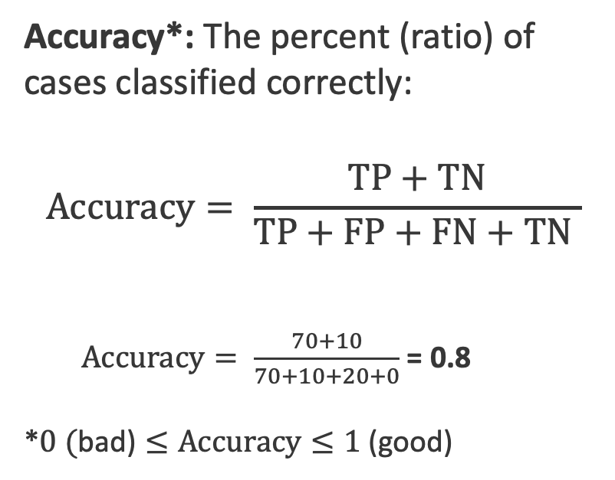
Classification - Accuracy
Prediction
Positive
Negative
Accuracy*: The percent (ratio) of cases classified correctly:
$$Accuracy= \frac{TP+TN}{TP+FP+FN+TN }$$
$Accuracy= \frac{70+10}{70+10+20+0}$ = 0.8
*$0 (\text{bad}\text{)}≤Accuracy≤1\text{ (}\text{good}\text{)}$
(TP)
True Positive
(FN)
False Negative
Positive
70
0
True State
(FP)
False Positive
(TN)
True Negative
Negative
20
10

Slide 51
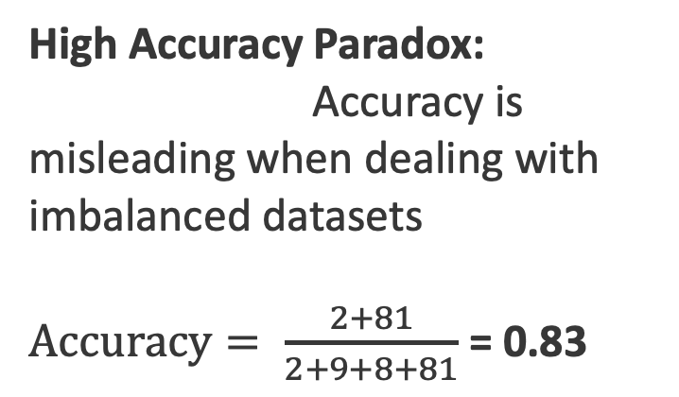
Classification - Accuracy
Prediction
Positive
Negative
High Accuracy Paradox:
Accuracy is misleading when dealing with imbalanced datasets
$Accuracy= \frac{2+81}{2+9+8+81}$ = 0.83
(TP)
True Positive
(FN)
False Negative
Positive
2
9
True State
(FP)
False Positive
(TN)
True Negative
Negative
8
81

Slide 52
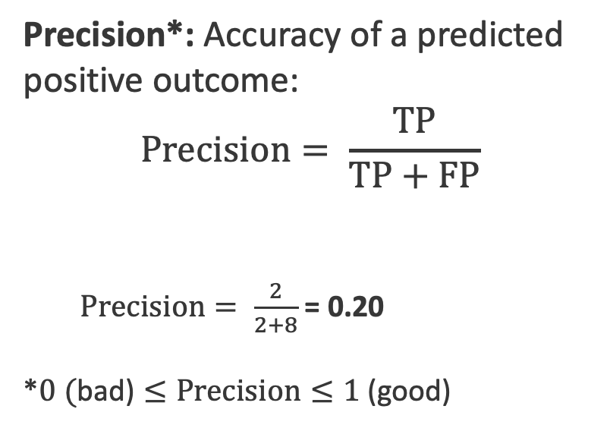
Classification - Precision
Prediction
Positive
Negative
Precision*: Accuracy of a predicted positive outcome:
$$Precision= \frac{TP}{TP+FP}$$
$Precision= \frac{2}{2+8}$ = 0.20
*$0 (\text{bad}\text{)}≤Precision≤1\text{ (}\text{good}\text{)}$
True Positive
False Negative
Positive
2
9
True State
False Positive
True Negative
Negative
8
81

Slide 53
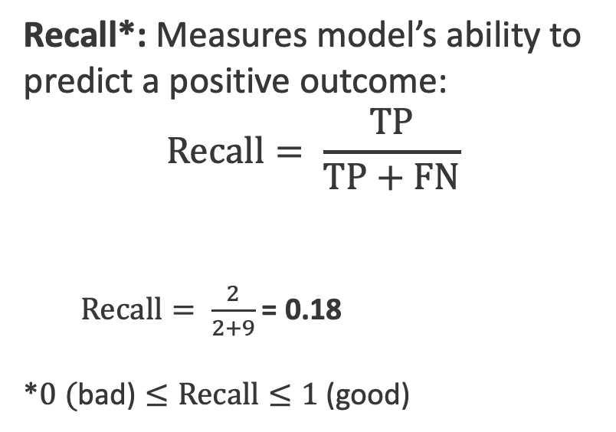
Classification - Recall
Prediction
Positive
Negative
Recall*: Measures model’s ability to predict a positive outcome:
$$Recall= \frac{TP}{TP+FN}$$
$Recall= \frac{2}{2+9}$ = 0.18
*$0 (\text{bad}\text{)}≤Recall≤1\text{ (}\text{good}\text{)}$
True Positive
False Negative
Positive
2
9
True State
False Positive
True Negative
Negative
8
81

Slide 54
Classification Metrics: F1 Score
F1 Score*: A combined metric, the harmonic mean of Precision and Recall.
Recall
F1 Score
Low when one or both of the Precision and Recall are low
High when both Precision and Recall are high
Precision
Notes:
With most imbalanced dataset scenarios, there’s usually a debate over whether your business problems should improve on precision or recall,
That is say, for our rare case scenario,
whether the classifier should do better on, increase
Precision (that will be equivalent to predicting less FalsePos, minimize the number of healthy people brought in for tests/treatments when not needed)
Or should do better, increase
Recall (equivalent to predicting less FalseNeg, reducing the no of people that have the disease and never find out)
To settle the debate, or rather balance these diff business choices,
F1 score is another score/metric that can be used to basically
maintain a balance between the precision and recall of your classifier
As we can see from this heat map of f1 score vs precision and recall values,
F1 is Low when one or both of the Precision and Recall are low
Also, F1 is high when both the Precision and Recall are high
````````````````
F1\,Score = \frac{2*(Precision * Recall)}{Precision+Recall}
0 \leq F1/,Score \leq 1

Slide 55
Artificial Neurons & Activation Functions

Slide 56

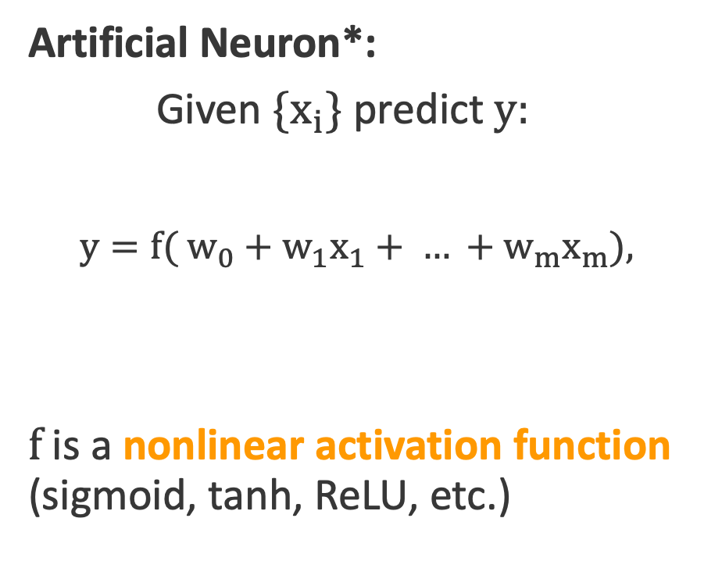
Artificial Neuron
Weights
Artificial Neuron*:
Given {$x_{i}$} predict $y$:
$y={f( w}_{0}+w_{1}x_{1}+ … +w_{m}x_{m}$),
f is a nonlinear activation function (sigmoid, tanh, ReLU, etc.)
w₀
w₁ x₁
x₁
x₂
w₂ x₂
Weighted
Sum
f
$$y$$
Weighted Sum
w₃ x₃
Output
x₃
Inputs
Activation
function

Slide 57
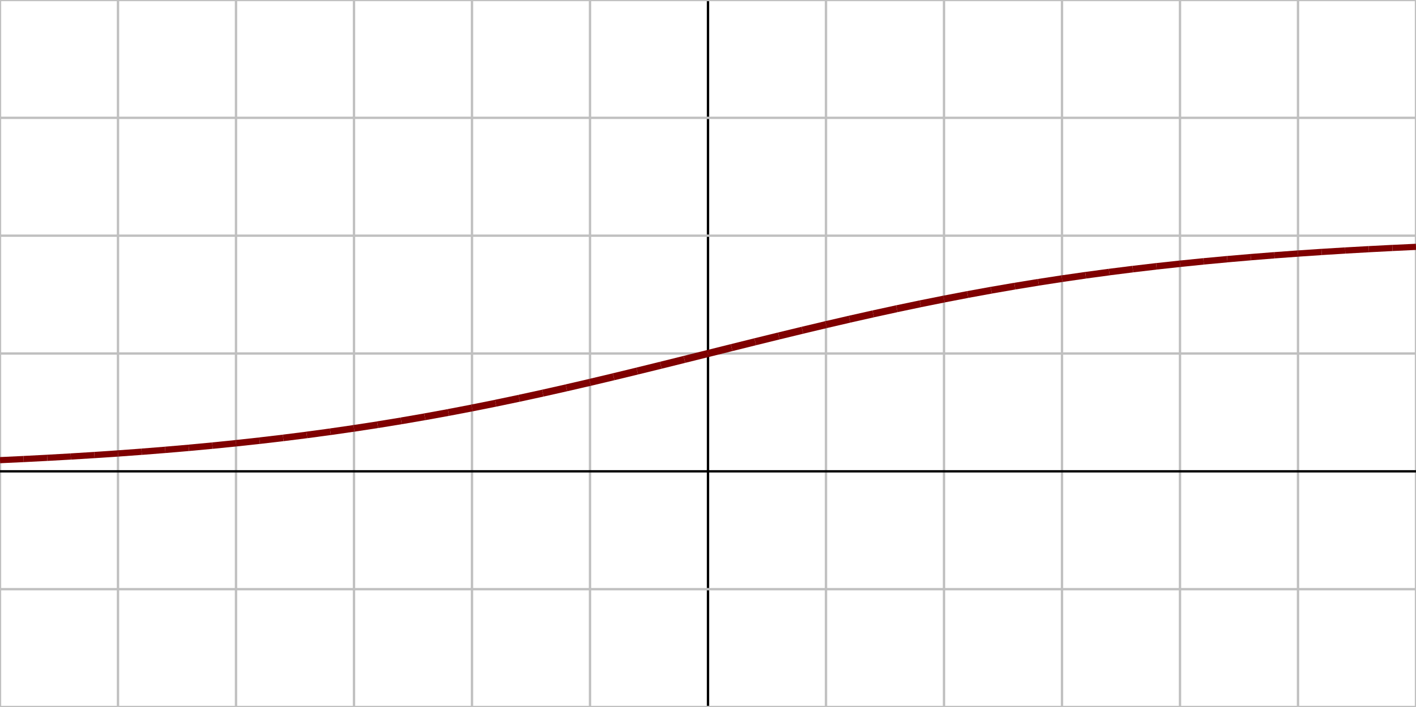
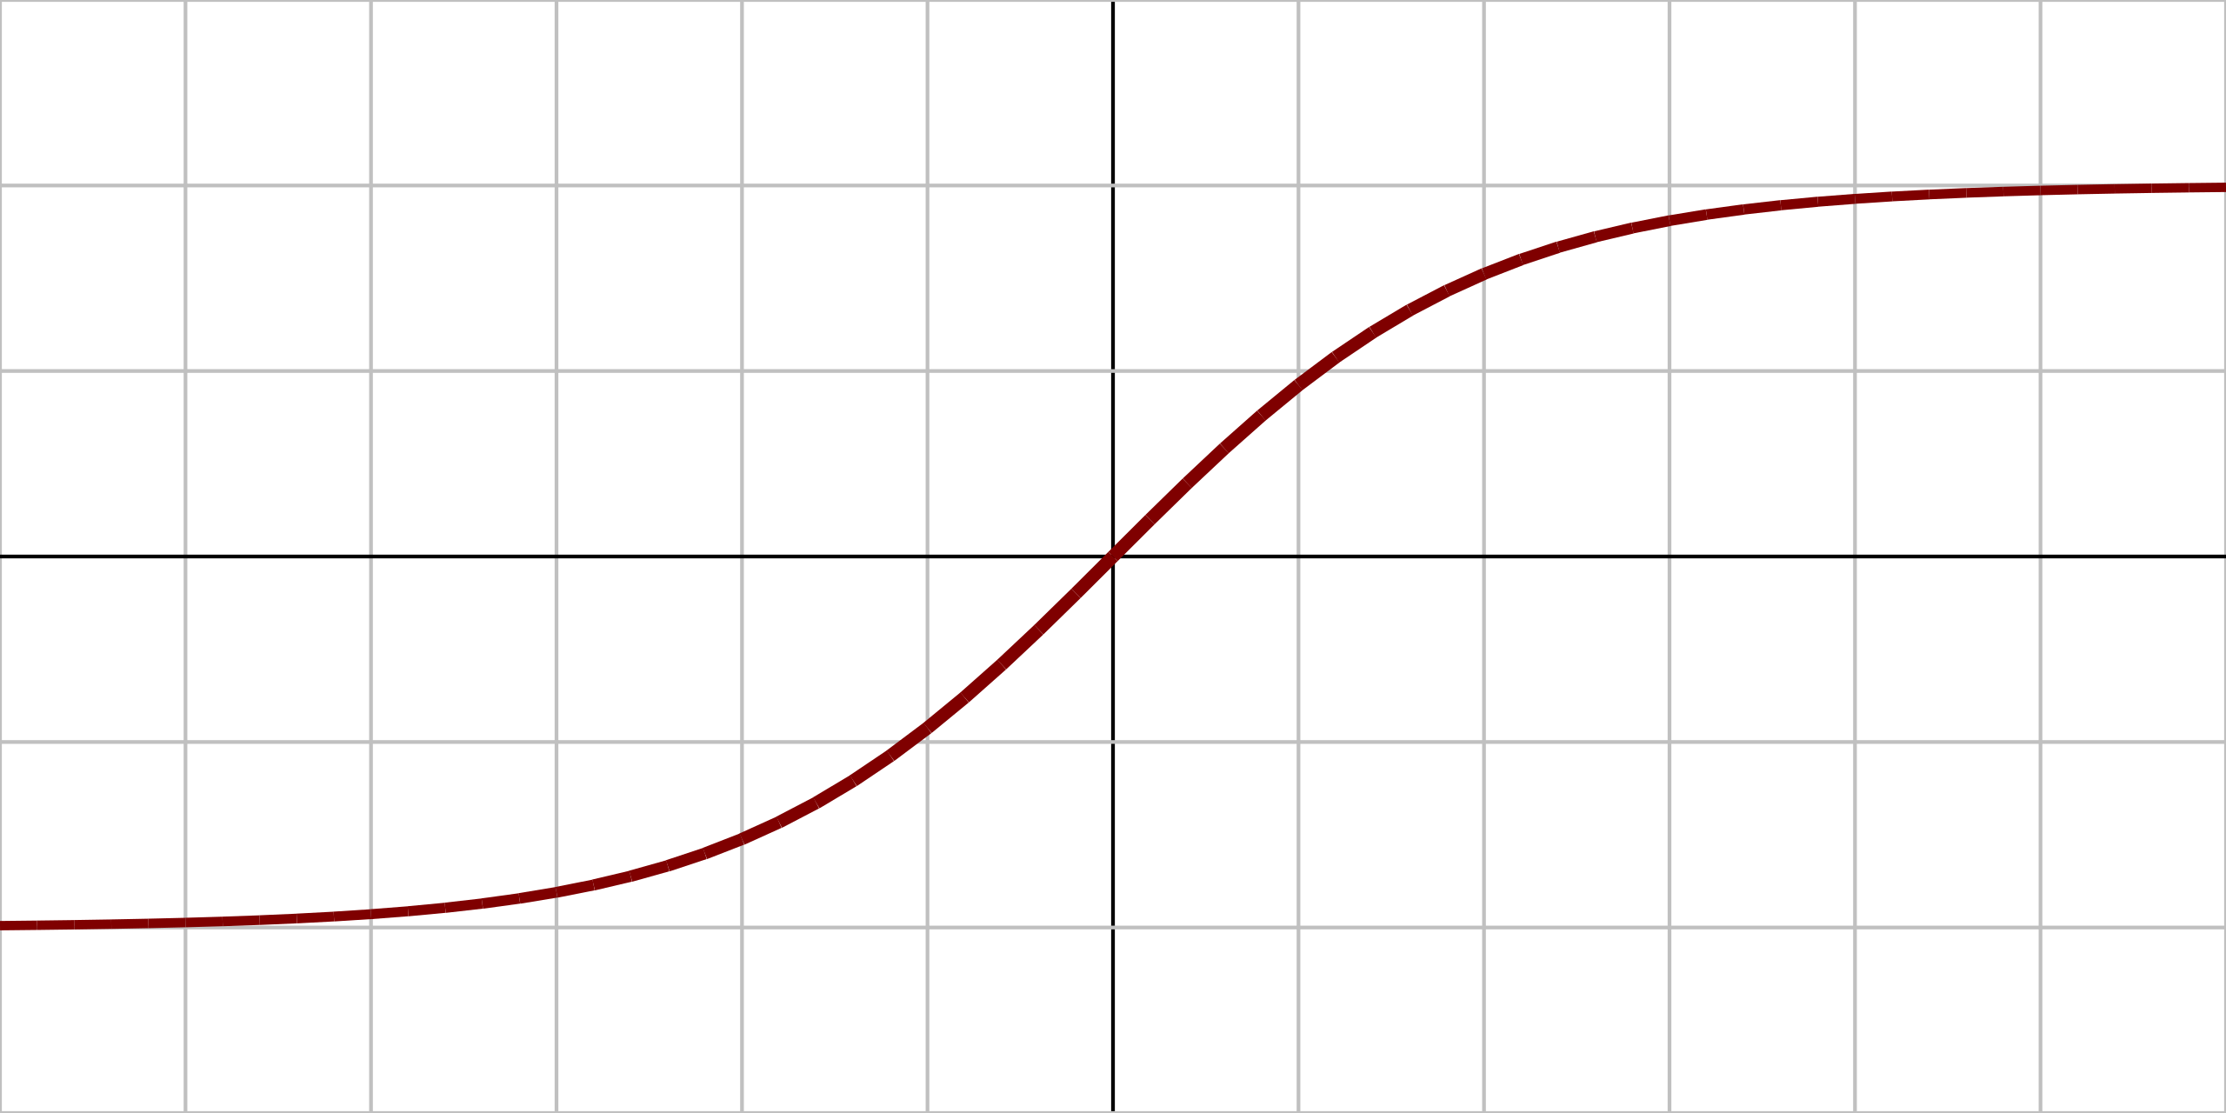
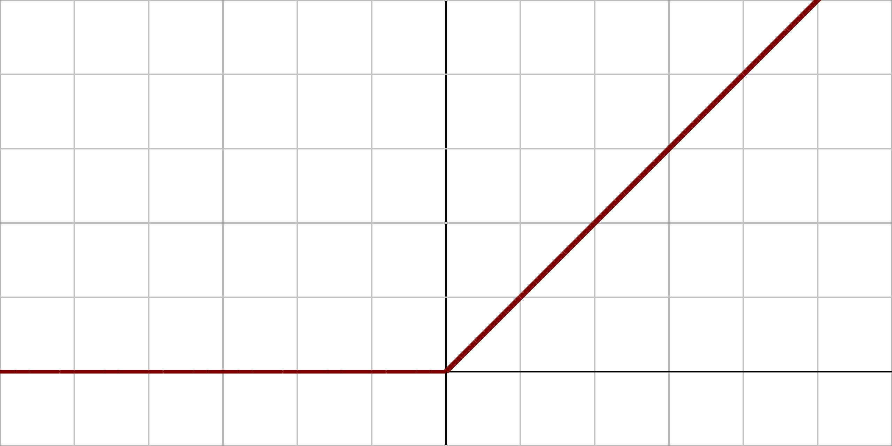
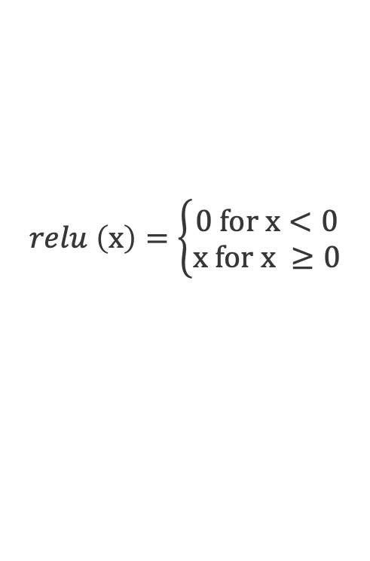
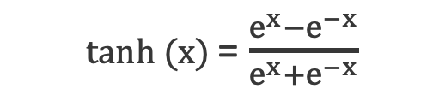
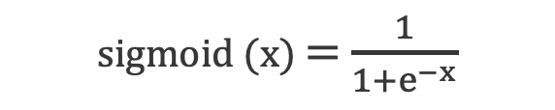
Activation Function
A differentiable operator at each neuron that transforms input signals to outputs, with adding non-linearity, e.g.,
Derivatives of these functions are also important for optimization.
Sigmoid
Hyperbolic tangent (tanh)
Rectified Linear Unit (ReLU)
1
sigmoid (x) = $\frac{1}{1+e^{−x}}$
0
x
1
tanh (x) = $\frac{e^{x}−e^{−x}}{e^{x}+e^{−x}}$
x
-1
$$relu \left(x\right)=\left\{\begin{aligned}0 for x<0 \\ x for x ≥0\end{aligned}\right.$$
0
x

Slide 58
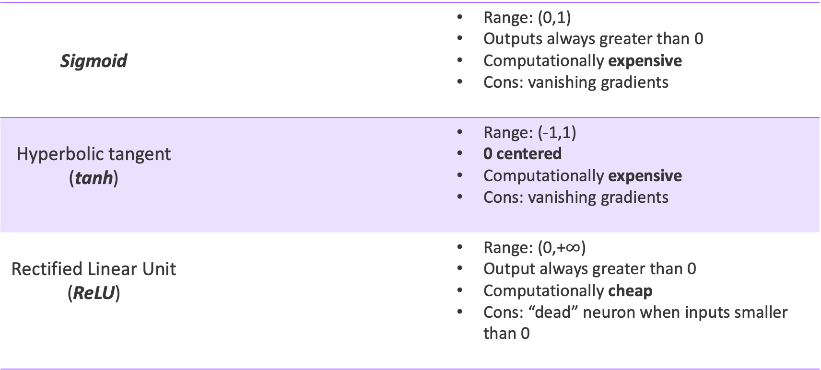
Activation Function
Sigmoid |  | Range: (0,1) Outputs always greater than 0 Computationally expensive Cons: vanishing gradients
Hyperbolic tangent (tanh) |  | Range: (-1,1) 0 centered Computationally expensive Cons: vanishing gradients
Rectified Linear Unit (ReLU) |  | Range: (0,+$∞$) Output always greater than 0 Computationally cheap Cons: “dead” neuron when inputs smaller than 0
1
0
x
1
x
-1
0
x

Slide 59
Neural Networks

Slide 60
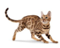
Neural Network
A simple Neural Network :
3 parts: one input layer, one or more hidden layer(s) and one output layer
Layers are connected
Each layer’ neurons use the same activation function
Also refers as a Multilayer Perceptron (MLP)
Dense/Linear layer
More details
Flatten

Slide 61
Forward Propagation
Outputs:
Hidden:
Inputs:

Slide 62
Training
To “train” a model, we need to optimize the cost function C(w).
Also called objective function or loss function
w refers to the weights / parameters / coefficients of the model
Backpropagation searches for the weights that minimize the cost function.

Slide 63
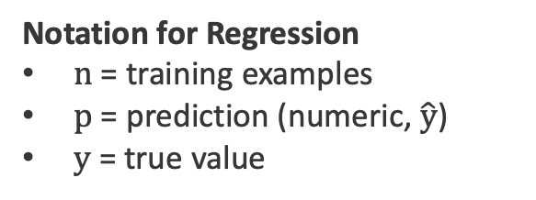
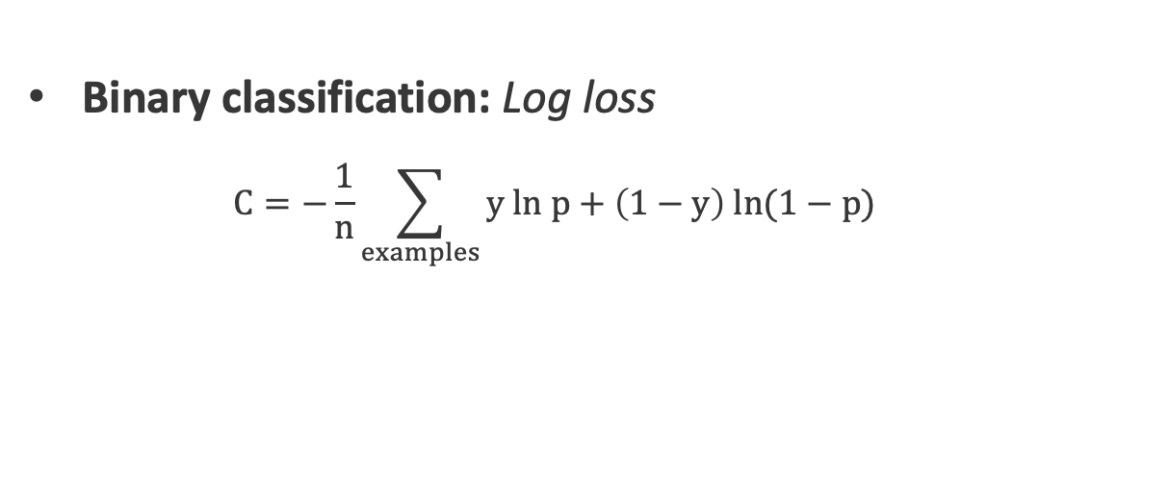
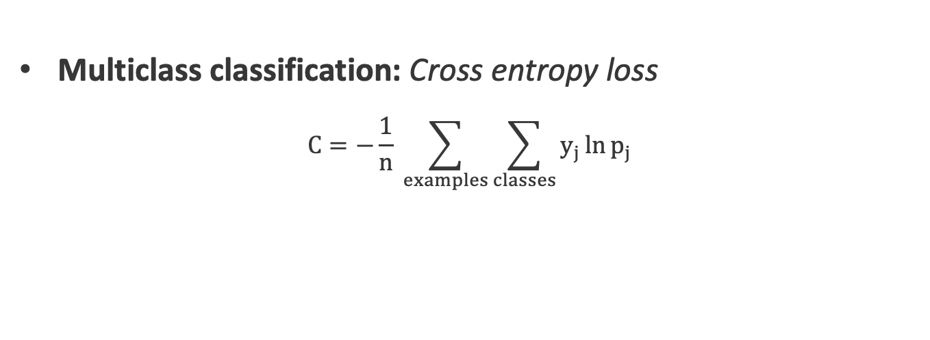
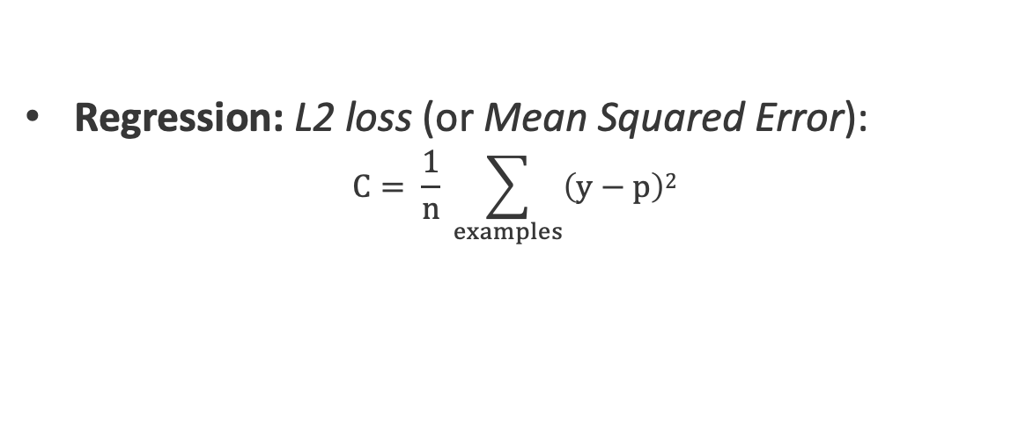
Cost Function
“How to measure the error?”
Binary classification: Log loss
$$C=−\frac{1}{n}\sum_{examples}{y ln p+\left(1−y\right) ln(1−p)}$$
Notation for Classification
n = training examples
j = classes
p = prediction (probability)
y = true class (1/yes, 0/no)
Multiclass classification: Cross entropy loss
$$C=−\frac{1}{n} \sum_{examples}{\sum_{classes}{y_{j}\ln{p_{j}}}}$$
Regression: L2 loss (or Mean Squared Error):
$$C= \frac{1}{n} \sum_{examples}{\left(y−p\right)2}$$
Notation for Regression
n = training examples
p = prediction (numeric, $\hat{y}$)
y = true value

Slide 64
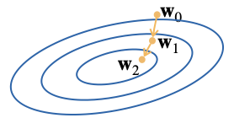
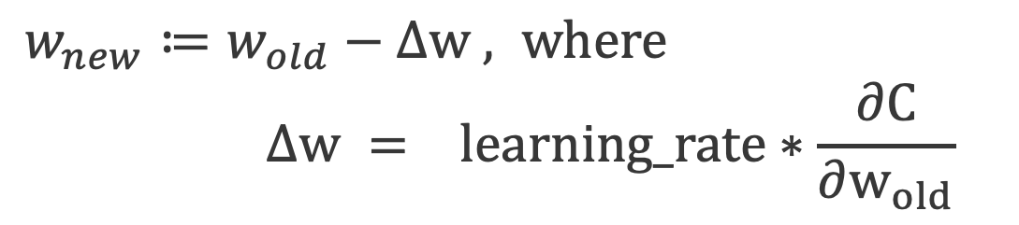
Backpropagation
Gradient descent:
An optimization method used to train neural networks
Moving towards the direction of the steepest descent iteratively
At each weight update:
$w_{new}≔w_{old}−∆w$ $, where$
$${ ∆w = }_{}learning_rate∗\frac{∂C}{∂w_{old}}$$
Gradient with respect to $w_{old}$

Slide 65
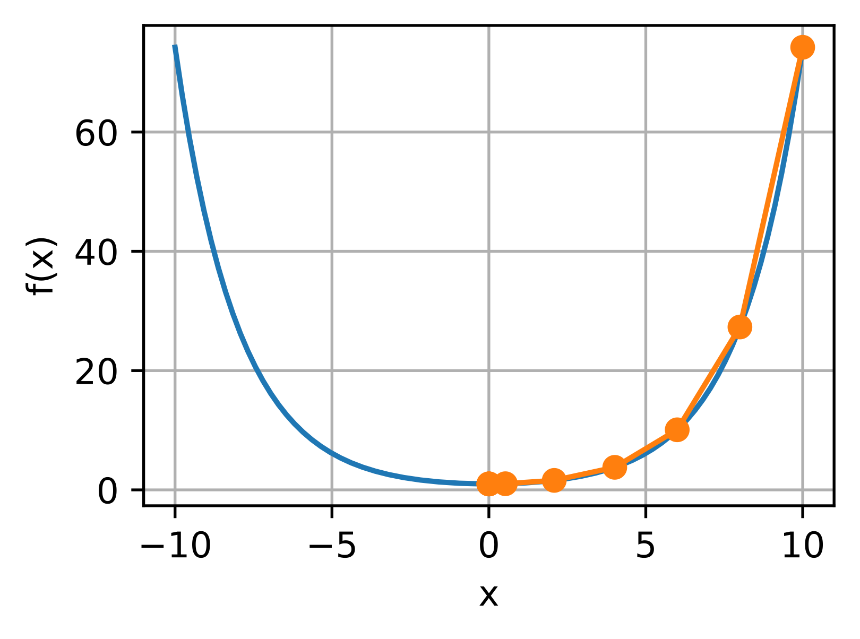
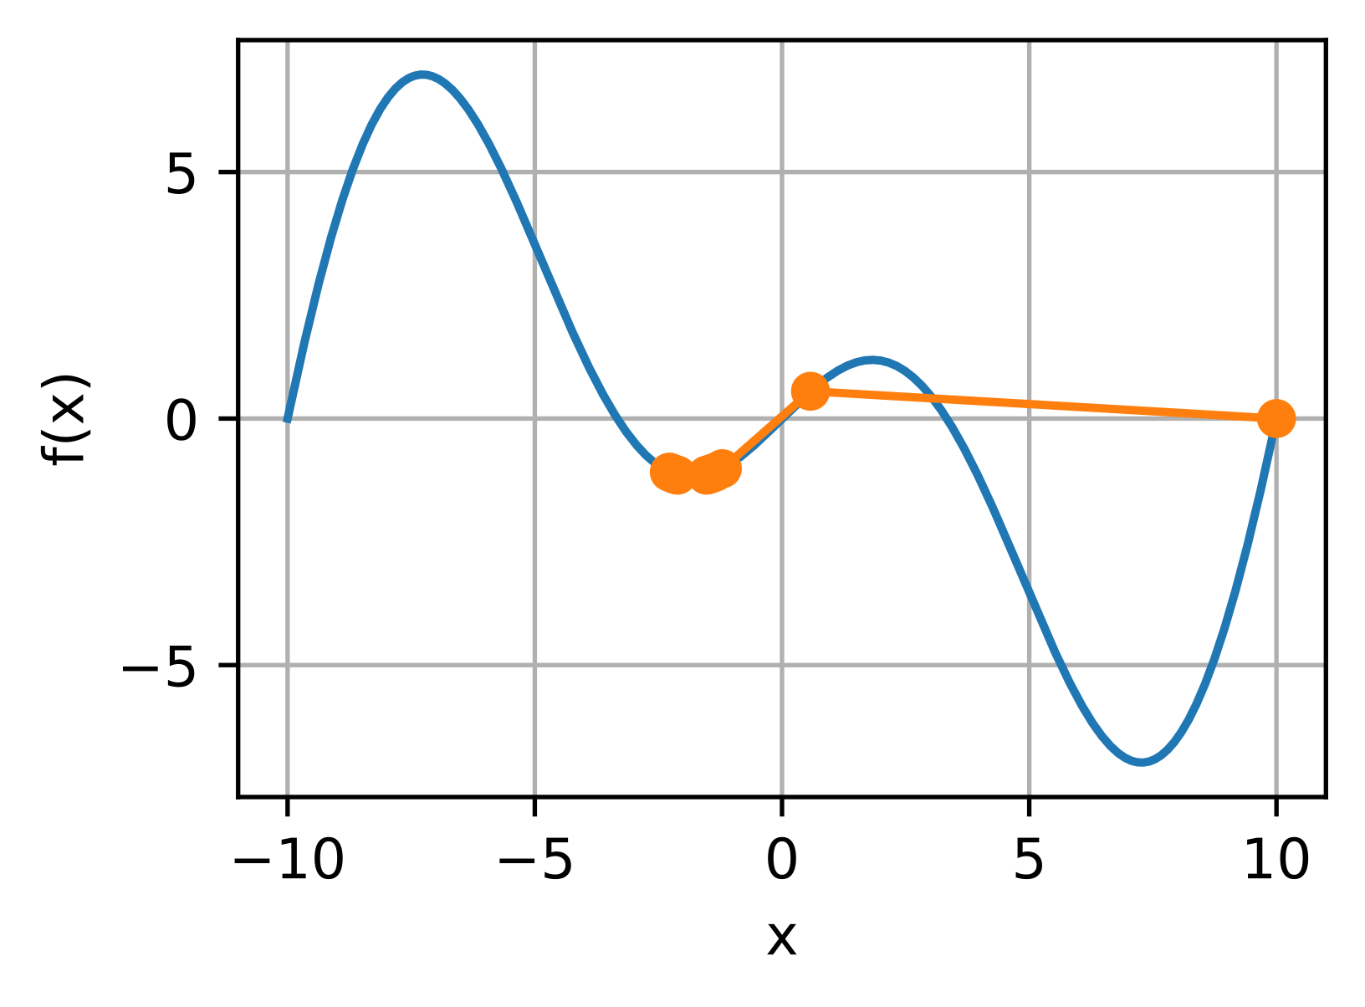
Gradient Descent
Initial Weights
Gradient
Global Cost Minimum

Slide 66

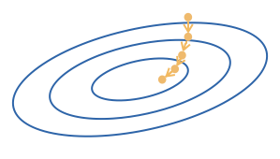
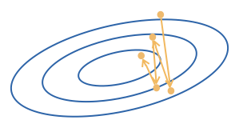
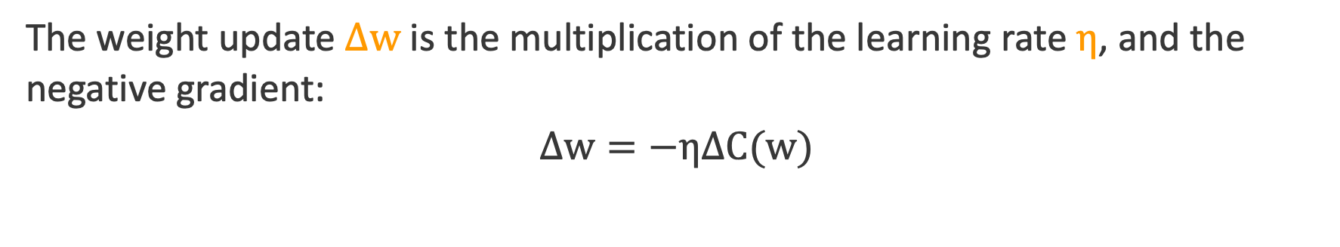
Learning Rate
The weight update $∆w$ is the multiplication of the learning rate $η$, and the negative gradient:
$$∆w=−η∆C(w)$$
Too small…
Too big…

Slide 67
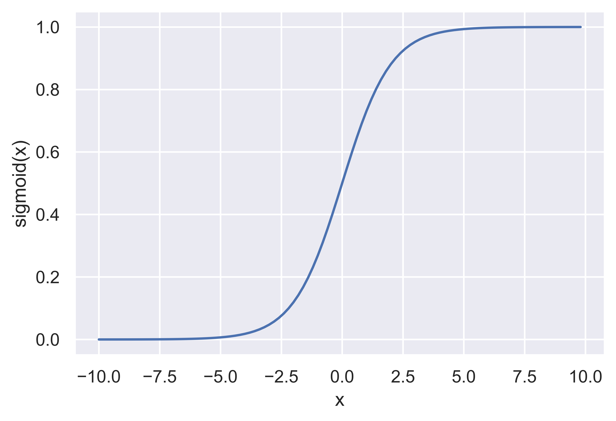
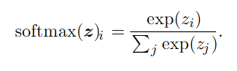
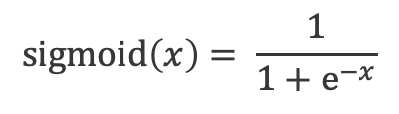
Output Function
“How to output/predict a result”
Binary classification: Sigmoid
Outputs a probability, P (class | x) in (0,1)
Multi-class classification: Softmax
Outputs a list of probabilities
Each probability represents for a class
Sum to be 1 (probability distribution)
Regression: Linear
$$sigmoid\left(x\right)= \frac{1}{1+e^{−x}}$$

Slide 68
Summary: Deep Learning Jargons
Model Design
Architectures (# of layer, # of neurons at each layer, etc.)
Activation Function
A differentiable “nonlinear mapping”
Output Function
A function to predict ”y”
Cost/Loss Function
A differentiable function to optimize the model
Evaluation Function
An often non-differentiable function to evaluate the model

Slide 69
Machine Learning with
Graph Data
Notes:
All looked great with the applications and theory discussed, but real life graph data – that’s another (long) story
- What is the typical process of building ml models on top of graphs?
What type of tasks?
what type of data?
graphs are heterogeneous or homogeneous
Graphs are multirelational?
How big are these graph datasets?

Slide 70
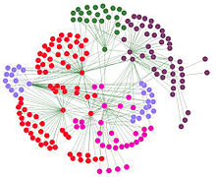
Typical Graph ML Flow
Node classification
Pre-process and prepare training and testing sets
Build and train GNN models
Link Prediction
Graph Classification

Slide 71
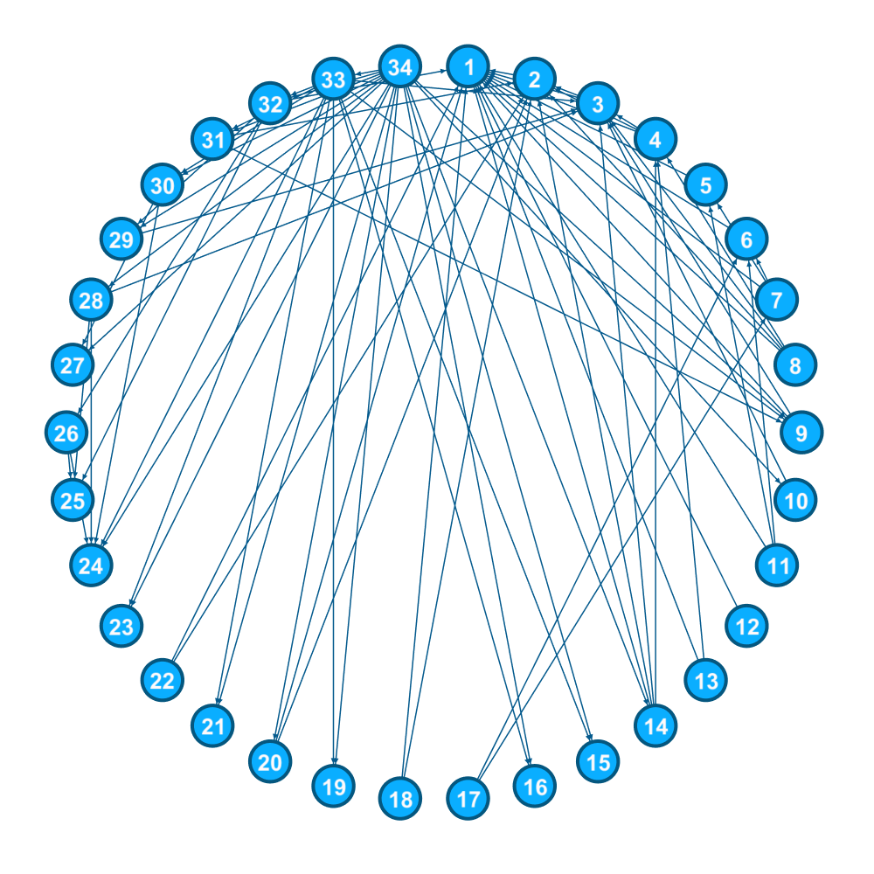
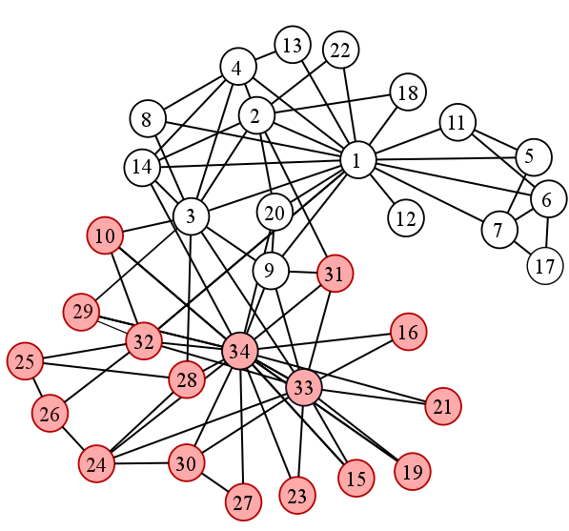
Zachery’s Infamous Karate Club
Notes:
Zachary’s Karate Club is a well-known dataset that describes the relationships in a university karate club, used by Wayne W. Zachary in his paper “An Information Flow Model for Conflict and Fission in Small Groups.”
This dataset is famous for its clear depiction of community structure, which occurs when nodes of a network can be grouped into densely connected sets.

Slide 72
Zachery’s Infamous Karate Club
A social network of a karate club.
34 members of a karate club
Links between pairs of members who interacted outside the club.
Walkthrough Notebook
Notes:
The network captures 34 members of a karate club, documenting links between pairs of members who interacted outside the club.
During the study a conflict arose between the administrator "John A" and instructor "Mr. Hi" (pseudonyms), which led to the split of the club into two.
Half of the members formed a new club around Mr. Hi; members from the other part found a new instructor or gave up karate.
Based on collected data Zachary correctly assigned all but one member of the club to the groups they actually joined after the split.
NOTEBOOK: MLA-GML-Week1_KarateClub.ipynb

Slide 73
Node Classification
Inference of node attributes/information based on its relations with other nodes in a graph and graph structure.
Breaks independent & identically distributed (iid) assumption.
Supervised or semi-supervised task
Use Case:
Detect Malicious Accounts
Target right customers

Slide 74
Link Prediction
Inference of links/edges and their attributes in a graph.
Popular examples: Content Recommendation, Knowledge base completion
Supervised or semi-supervised task
Use Case:
Recommendations
Predict missing relations in a Knowledge Graph

Slide 75
Graph Classification
Inference on entire graphs in a collection of graphs.
Popular Examples: Molecule Property Prediction,
Supervised task
Use Case:
Property prediction of chemical compounds

Slide 76
Karate Club
DGL
Walkthrough
Amazon
SageMaker

